Slide 1
Team: High flyers
Russ McGrath
Sharmila Sainani
Alexandra Zelcer
Tony Joy

Slide 2
United States Live Wild Fire Analysis

Slide 3
Project Summary Heroku hosting
The National Wildfire Coordinating Group collects and shares information regarding currently active wildfires in the western United States.
This project collects this data and creates a series of interactive maps to display visual representations of the current state of wildfires in the western US.
Project has been shared on Heroku at:
https://wildfires-teamflyinghigh.herokuapp.com/

Slide 4
ETL Process
Extract
Transform
Load

Slide 5
Data Extraction
Source:
National Wildfire Coordinating Group’s Incident Information System
https://inciweb.nwcg.gov/feeds/rss/incidents/
Parse RSS Feed (XML)
Digging Deeper
Reverse Geomapping
Parse the source page using Beautifle Soup with an XML parser
Determine the XML tag which represents each data “row”
Cycle through each instance of this tag and store the data in a series of list
Convert lists into a Pandas dataframe
Visit incident page for each fire
Grab the data tables, using Pandas read_html
Extract cause and size data from the tables
Feed lat/lon coordinates for each fire into Google’s Geomapping API to determine which state the fire is located in
(Used in generating choropleth map)
Result: Complete Data (Pandas Dataframe)

Slide 6
Data Transformation
Consolidate Fire Causes
Strip Fire Acreage Value
Handle data gaps
Unknown
Under Investigation
Investigating
Unknown / Under Investigation
“Unknown”
“Under Investigation”
“Investigating”
“Unknown/Under Investigation”
“213,945 Acres”
[no data]
“Unknown”
“213945”
“n/a”
Result: Clean Data (Pandas Dataframe)

Slide 7

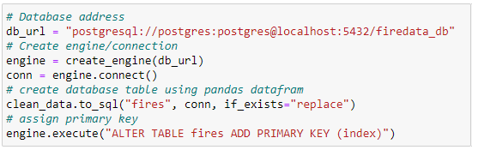


Data Loading
Result: postgresql Database

Slide 8
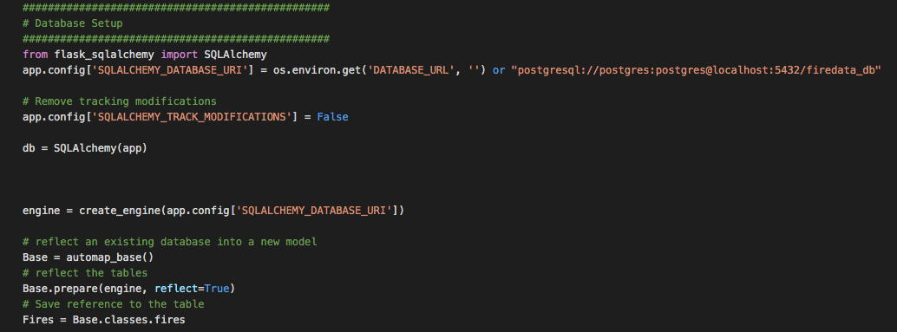
Flask Server
Setting the flask server up and linking the endpoints to the corresponding map
Transformed the data into dictonary format that can be jsonified

Slide 9
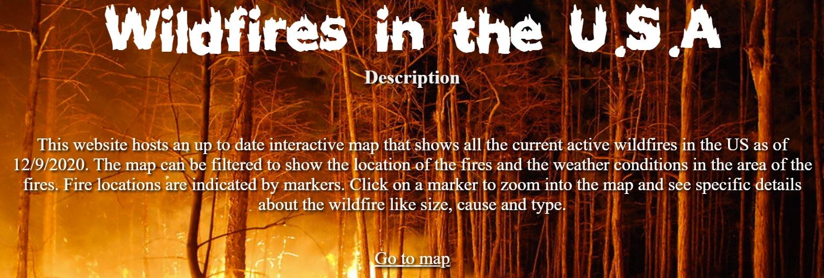
HTML/CSS
The website hosts the marker map, heat map, and choropleth map.
The main page features:
Animated background photo
Description
Links to the maps

Slide 10
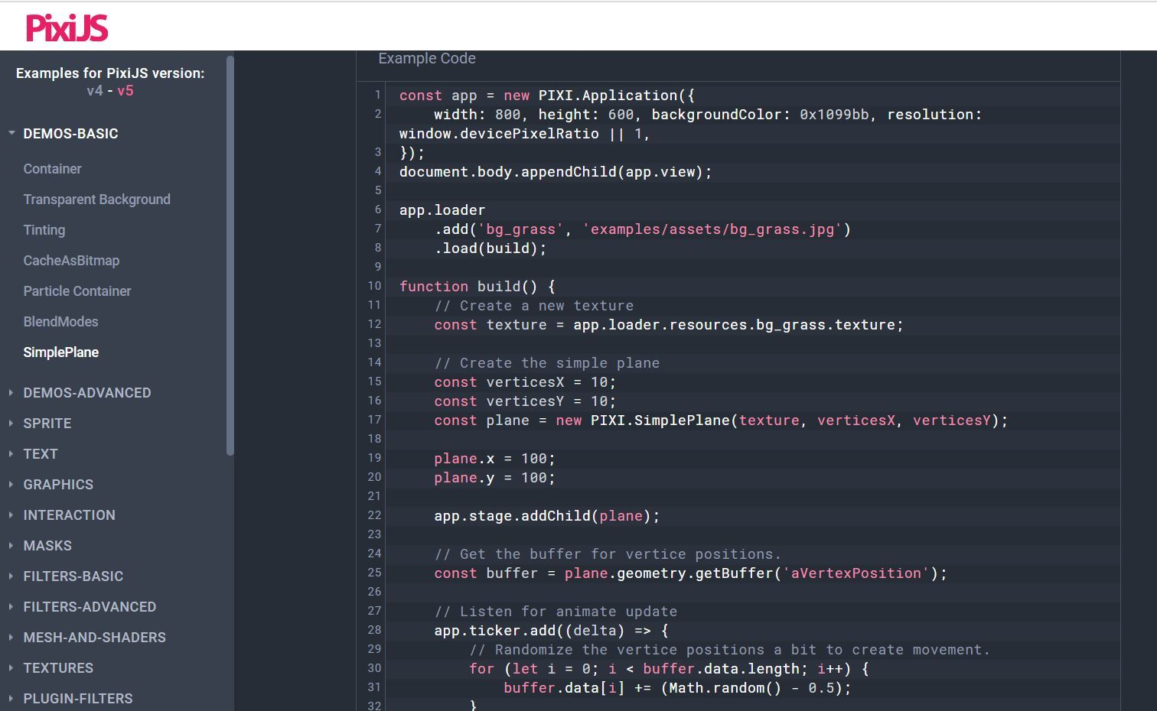
PIXI.js
Pixi.js is a rendering library that allows you to create interactive graphics, cross platform applications, and games
This library was used to animate the background photo on our website
www.pixijs.com

Slide 11
Interactive Maps
Marker Map
Heatmap
Choropleth Map

Slide 12
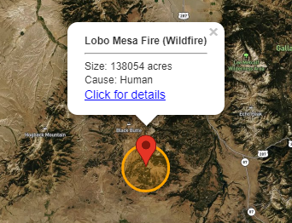
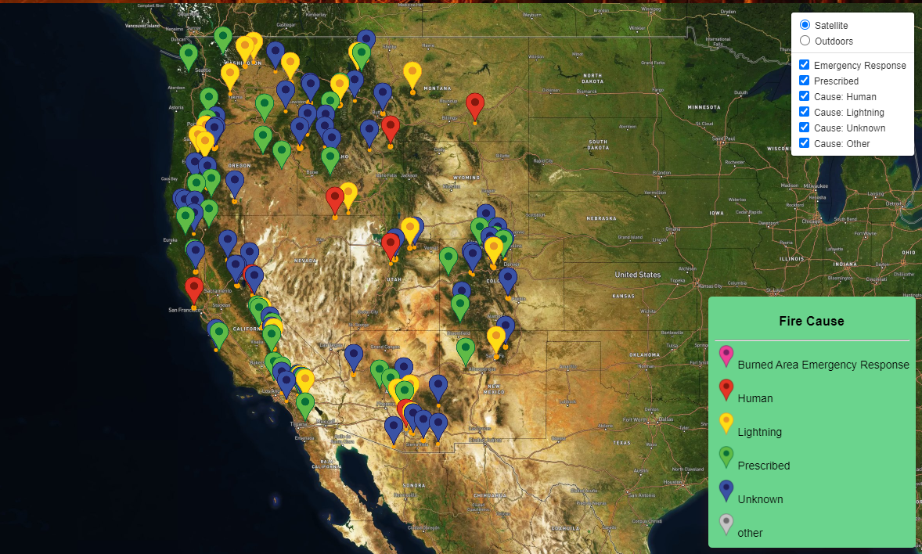
Wildfire Markers Map
This map places a marker on the location of each wildfire, and a circle representing that fire’s burn area.
Features:
On marker click, pan/zoom to fire location
On marker click, display details about the fire
Different marker colors are used corresponding to the fire’s cause
Ability to toggle markers on and off by cause
Legend responds to toggling by graying out the turned off marker icon

Slide 13
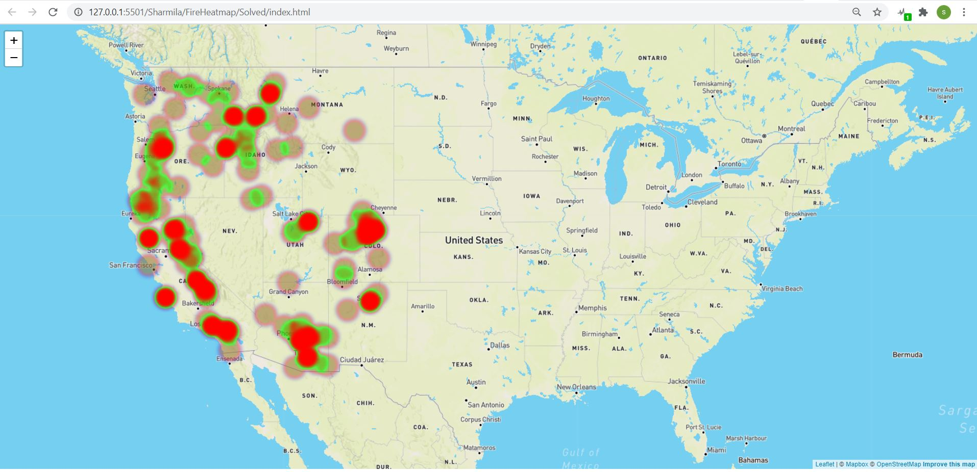
Heat map
In this heatmap data visualization the range of colors represent the density of points in a particular area.
2) This map helps us see the “shape” of the data and highlight areas of concentration where many points are clustered closely together.

Slide 14
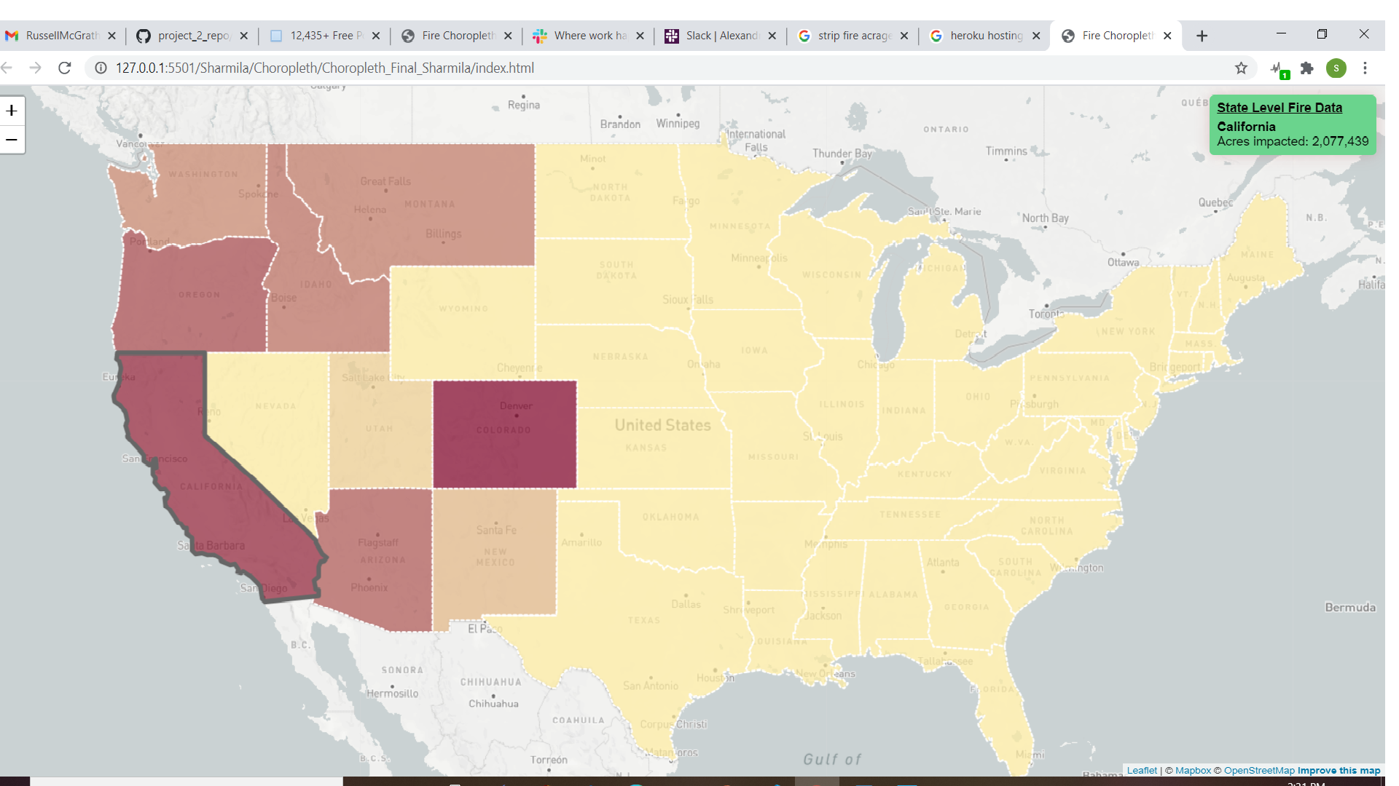
Choropleth Map
1)In this choropleth map we visualize the state level data.
2) By hovering over the state map you can see the total acers burned.

Slide 15
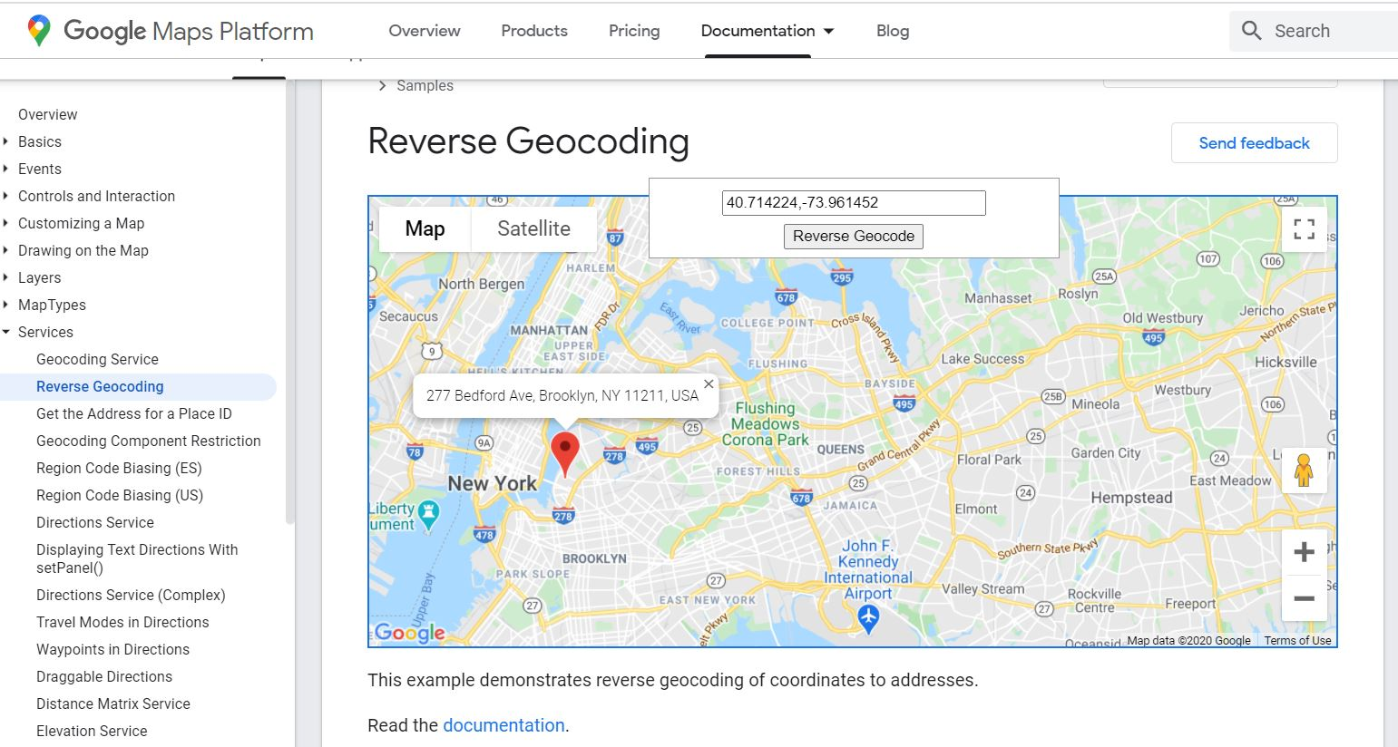
Reverse Geocoding
Feed the latitude and longitude coordinates for each fire into Google’s Geocode API to extract the complete data relating to the given coordinates and extracting the state info for the coordinates with fire data

Slide 16
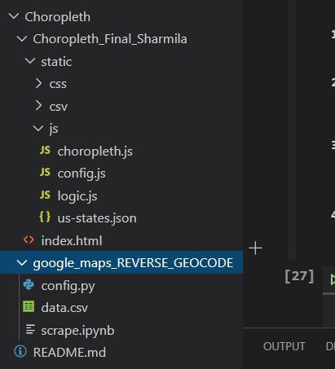
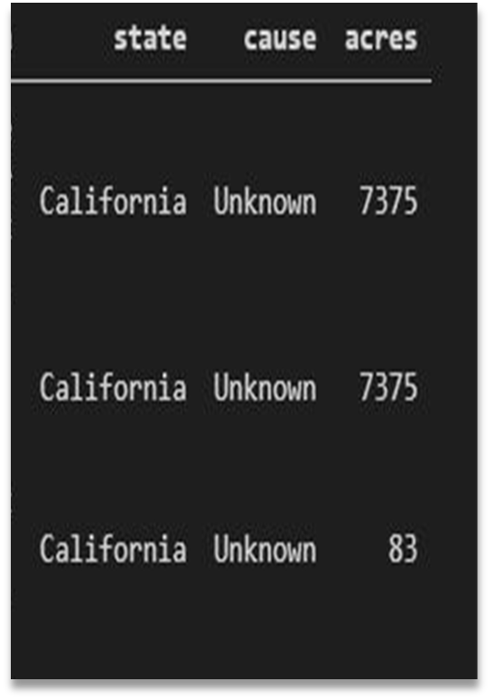
Files required columns generated
1) For this choropleth map we have used the additional file
US-States.json
2) Calculated the total acers burned in the state and added in Acers
column
3) Sate column being added

Slide 17
Challenges conquered
Adding required columns determining state based on Latitude and longitude date
Heat map result (beginner problem)
XML parsing
Flask endpoints
Heroku hosting

Slide 18
If we had more time
Technical:
Pixijs 2D java script library
Authentication
Mongo DB
More functional website
Informational:
Temperature Analysis
Air quality Analysis
Fire fighters resources Availability Analysis

Slide 19
Thank you
For your time
From Team: High Flyers

